Slide 1

Krantiguru Shyamji Krishna Verma
Kachchh University
Project Presentation
Created by:
Zola Jigar S.
Ruparel Pratham A.

Slide 2
Project Title
Smart Blind Stick
We Are Here For Blind Peoples.

Slide 3
Project Overview
Have you ever noticed blind people ?
Probleme :-
Their life is full of risk. They can’t walk without the help of others. Their life always depends upon others. Let’s make smothing for them so they can walk without any fear.
Solution :-
In our society many people had trouble walking in public and coming out at public places so for them we are made this product become an eye in their life. Blind person can walk without anyone’s help.the smart blind stick automatically detects objects in front of the person and give him a response to the person by bipping warning sound .
Through this , Blind person can aware about the objects in front of him.

Slide 4
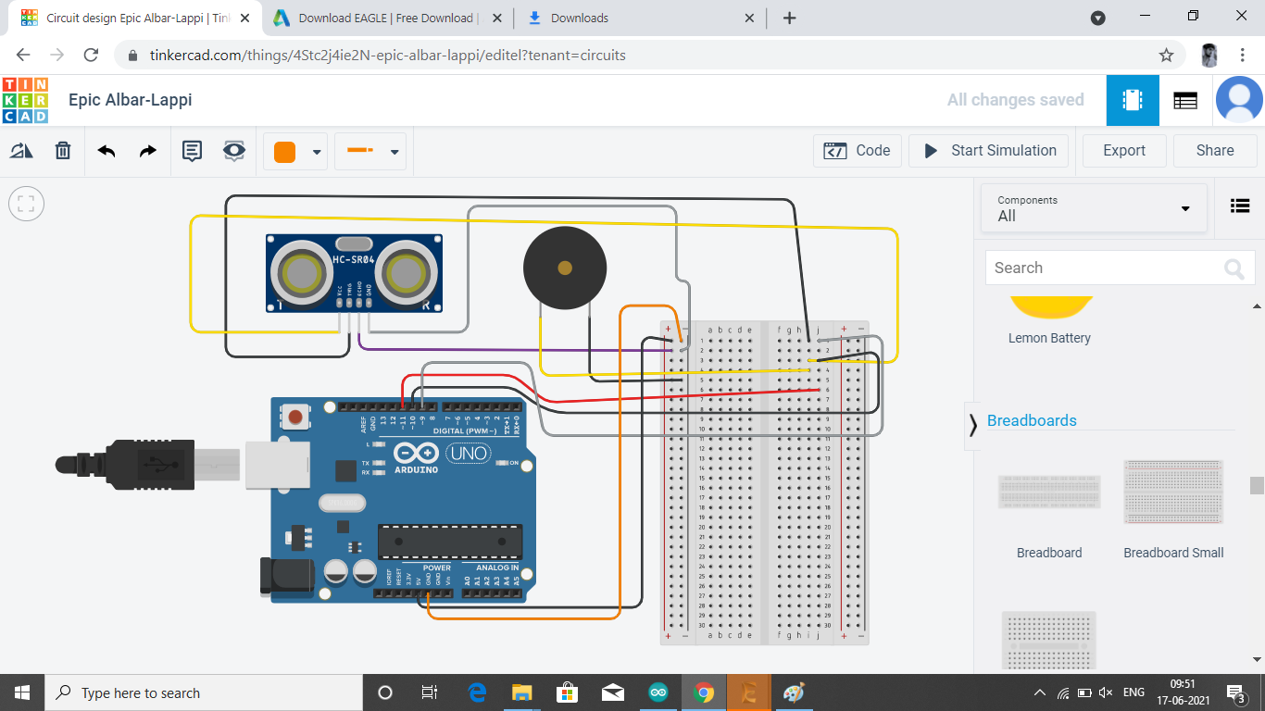
Circuit Diagram

Slide 5


Integrated Development Environment (IDE)
01
ARDUINO
02
TINKER CAD
( FOR CIRCUIT)

Slide 6
ARDUINO NANO
HARDWARE
ULTRASONIC SENSOR
BREAD BOARD
BUZZER

Slide 7


